Slide 1
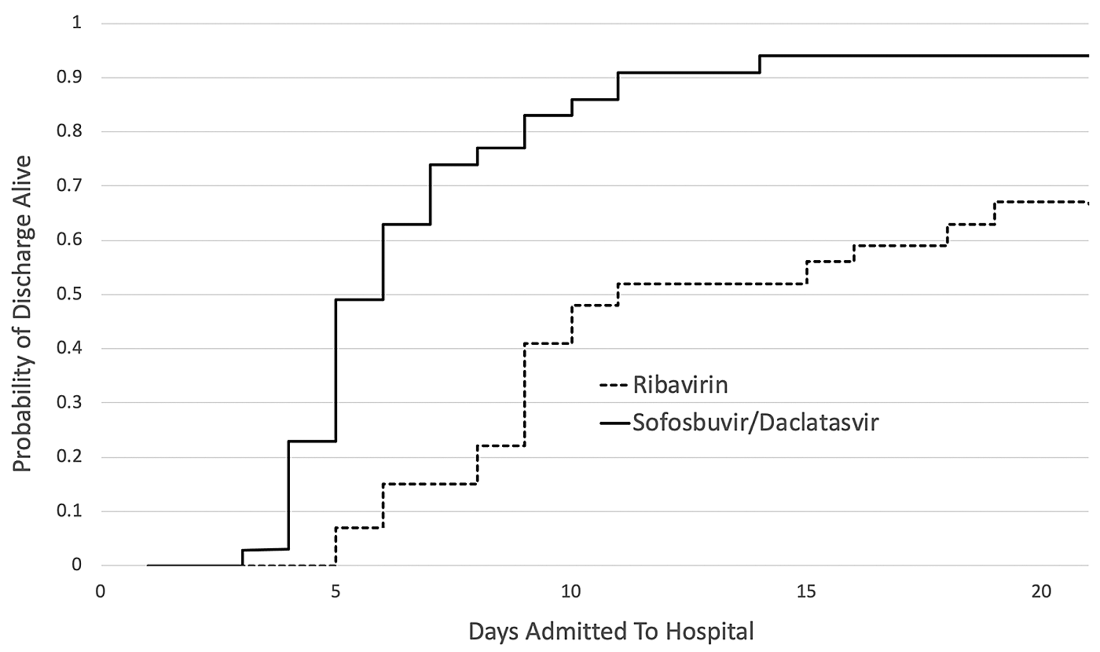
Figure 2. Cumulative probability of being discharged alive for the ribavirin and sofosbuvir/daclatasvir arms.
Notes:
Figure 2. Cumulative probability of being discharged alive for the ribavirin and sofosbuvir/daclatasvir arms.
Unless provided in the caption above, the following copyright applies to the content of this slide: © The Author(s) 2020. Published by Oxford University Press on behalf of the British Society for Antimicrobial Chemotherapy. All rights reserved. For permissions, please email: journals.permissions@oup.com.This article is published and distributed under the terms of the Oxford University Press, Standard Journals Publication Model (https://academic.oup.com/journals/pages/open_access/funder_policies/chorus/standard_publication_model)

